Slide 1
Data Parsing
Building Personal Websites
Lecture 11 | Data Parsing

Slide 2
Introduction to JSONs
Reading/Writing to JSONs
JSON for Web Development
Session Storage Overview
Accessing Stored Values Between Pages
Building Personal Websites
Lecture 11 | Data Parsing

Slide 3
J A V A
S C R I P T O B J E C T
N O T A T I O N
Building Personal Websites
Lecture 11 | Data Parsing

Slide 4
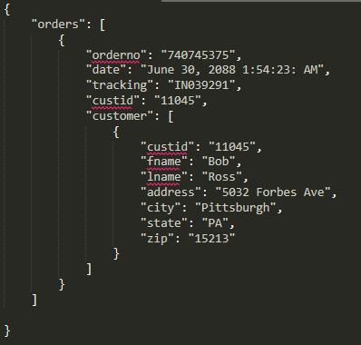
Example of a JSON
Building Personal Websites
Lecture 11 | Data Parsing

Slide 5
Introduction to JSONs
Reading/Writing to JSONs
JSON for Web Development
Session Storage Overview
Accessing Stored Values Between Pages
Building Personal Websites
Lecture 11 | Data Parsing

Slide 6
Opening JSON
Parses the file ‘data.json’ and stores the resulting object in variable data
$.getJSON( “data.json", function( data ) {} )
Robust: if ‘data.json’ is located and can be opened, function(data) is called. Otherwise getJSON() terminates and passes over function(data).
Building Personal Websites
Lecture 11 | Data Parsing

Slide 7
Reading JSON
What is printed as a result of running the code?
$.getJSON( “data.json", function( data ) {
var name = data[“orders”][0][“customer”][0][“fname”];
name += “ “;
name = data[“orders”][0][“customer”][0][“lname”];
console.log(name);
});
Building Personal Websites
Lecture 11 | Data Parsing

Slide 8
Reading JSON
The ‘customer’ field is an array of objects, which is why we access the [0] index before [“fname”]
$.getJSON( “data.json", function( data ) {
var name = data[“orders”][0][“customer”][0][“fname”];
name += “ “;
name = data[“orders”][0][“customer”][0][“lname”];
console.log(name);
});
object
array
Building Personal Websites
Lecture 11 | Data Parsing

Slide 9
Writing JSON
Writing is the opposite of reading, we assign the field a variable rather than a variable the field.
$.getJSON( “data.json", function( data ) {
data[“orders”][0][“customer”][0][“fname”] = “guy”; data[“orders”][0][“customer”][0][“lname”] = “fieri”;
});
object
array
Building Personal Websites
Lecture 11 | Data Parsing

Slide 10
Introduction to JSONs
Reading/Writing to JSONs
JSON for Web Development
Session Storage Overview
Accessing Stored Values Between Pages
Building Personal Websites
Lecture 11 | Data Parsing

Slide 11
Benefits of using JSONs
Great for storing large amounts of data
Easy to parse
Sounds like “Jason”, so you won’t forget it
Downsides of using JSONs
Comparatively slow read-write times
Easily breachable (don’t store personal data in it).
Building Personal Websites
Lecture 11 | Data Parsing

Slide 12
Scanning JSON
Separates each value in the upper-level region of data into key-and-value pairs
$.each( data, function( key, val ) {});
Building Personal Websites
Lecture 11 | Data Parsing

Slide 13
Scanning JSON
What will be printed as a result?
$.getJSON( “data.json", function( data ) {
$.each( data, function( key, val ) {
console.log(val);
});
});
‘orders’ is the only upper-level data entry, so:
key = ‘orders’
val = (everything between […])
Building Personal Websites
Lecture 11 | Data Parsing

Slide 14
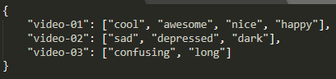
Scanning JSON
We can use JSONs to store related terms for element tags and retrieve them if a search matches one of its terms.
$.getJSON( “data.json", function( data ) {
$.each( data, function( key, val ) {
for( var k = 0; k < val.length; k++ ) {
if( val[k] == tag )
console.log( key );
}
});
});
Building Personal Websites
Lecture 11 | Data Parsing

Slide 15
Introduction to JSONs
Reading/Writing to JSONs
JSON for Web Development
Session Storage Overview
Accessing Stored Values Between Pages
Building Personal Websites
Lecture 11 | Data Parsing

Slide 16
Session Storage Library
Store item click-count with value 0
sessionStorage.setItem(”click-count”, 0)
Retrieve item click-count
sessionStorage.getItem(”click-count")
Check that item click-count is set
sessionStorage.getItem(”click-count") != null
Clear item click-count
sessionStorage.removeItem(”click-count")
Building Personal Websites
Lecture 11 | Data Parsing

Slide 17
Session Storage Library
Keeping track of clicks with sessionStorage:
$(‘body’).click( function () {
if ( sessionStorage.getItem(”click-count”) != null ) {
var count = sessionStorage.getItem(”click-count”);
sessionStorage.setItem(”click-count”, count++);
}
else {
sessionStorage.setItem(“click-count”, 0);
}
});
Building Personal Websites
Lecture 11 | Data Parsing

Slide 18
What is sessionStorage?
A simple way of storing values in JavaScript for repetitive use.
Optimal use is when wanting to share values between pages.
Why can’t I use a global variable instead?
Global variables are reset each time the page is reloaded.
sessionStorage values are saved in the browser’s cache and are not cleared until either:
The browser’s cache is cleared
The browser is closed.
Building Personal Websites
Lecture 11 | Data Parsing

Slide 19
Introduction to JSONs
Reading/Writing to JSONs
JSON for Web Development
Session Storage Overview
Accessing Stored Values Between Pages
Building Personal Websites
Lecture 11 | Data Parsing

Slide 20
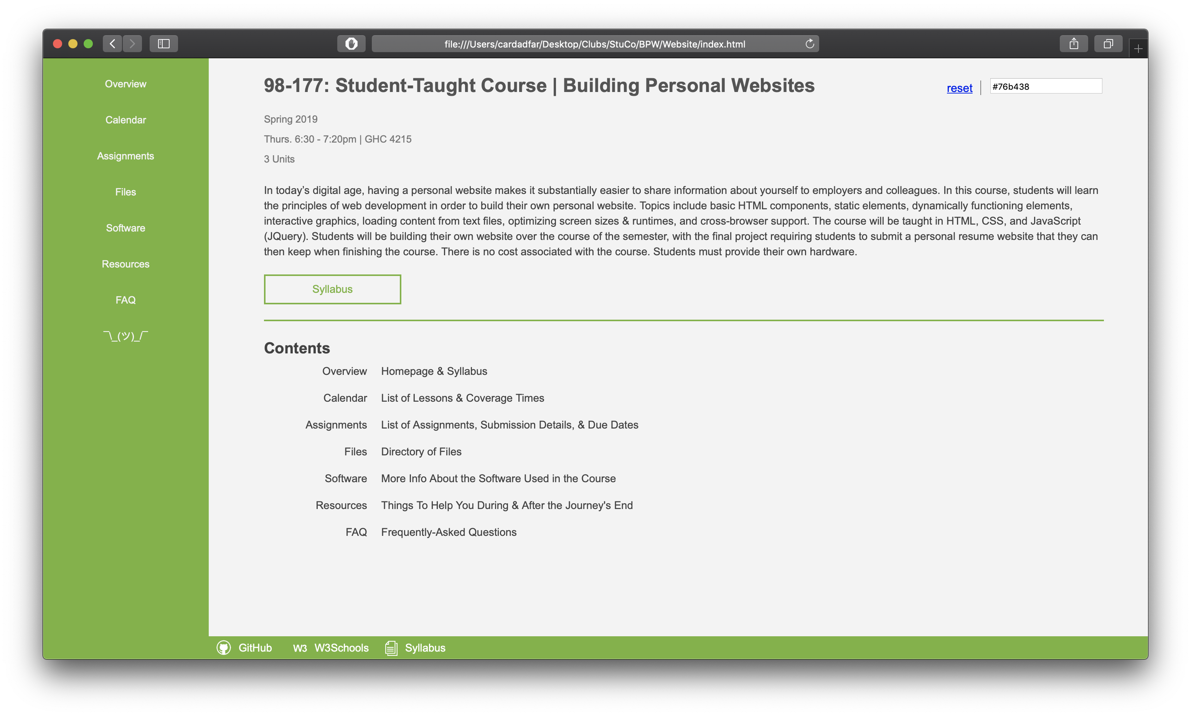
Color Storage
Building Personal Websites
Lecture 11 | Data Parsing

Slide 21
Instantiate Variables
Set sessionStorage
Create Color Selector on Statrtup
Update Color (Color Selector Event Handler)
Reset Color (Reset Button Event Handler)
Building Personal Websites
Lecture 11 | Data Parsing

Slide 22
If shared between HTML pages, each page can access bg_color variable
Building Personal Websites
Lecture 11 | Data Parsing

Slide 23
Homework Ideas
Use JSONs to create searchable keywords for HTML elements.
Use JQuery to toggle between elements of keywords similar to was inputted in a searchbar.
Store values from your site into a JSON and have JQuery load them on startup.
Building Personal Websites
Lecture 11 | Data Parsing

Slide 24
Live Demo
Building Personal Websites
Lecture 11 | Data Parsing

